Slide 1

Fitting models to data via simulation-based inference
Calum Gabbutt
16/02/2026

Slide 2
Learning outcomes…
Understand how to do parameter inference within a Bayesian framework
Understand the principles of likelihood-free inference
Appreciate the importance of summary statistics as a remedy for the curse of dimensionality
Know how normalising flows can be employed to perform amortised simulation-based inference

Slide 3
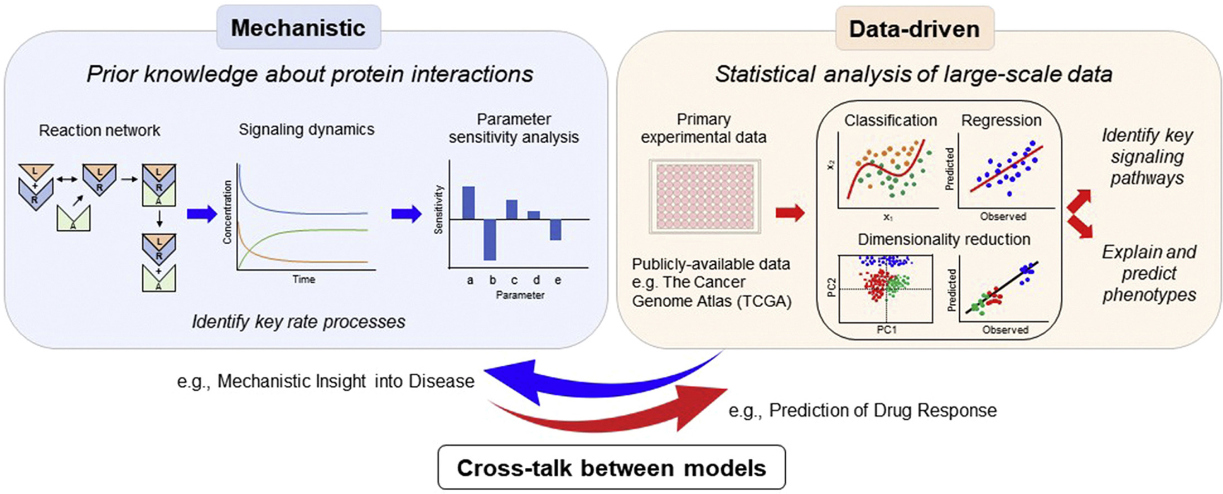
Data driven approaches are complementary to mechanistic modelling
Interpretability (extrapolation)
Prediction (interpolation)
Myers et al 2021

Slide 4
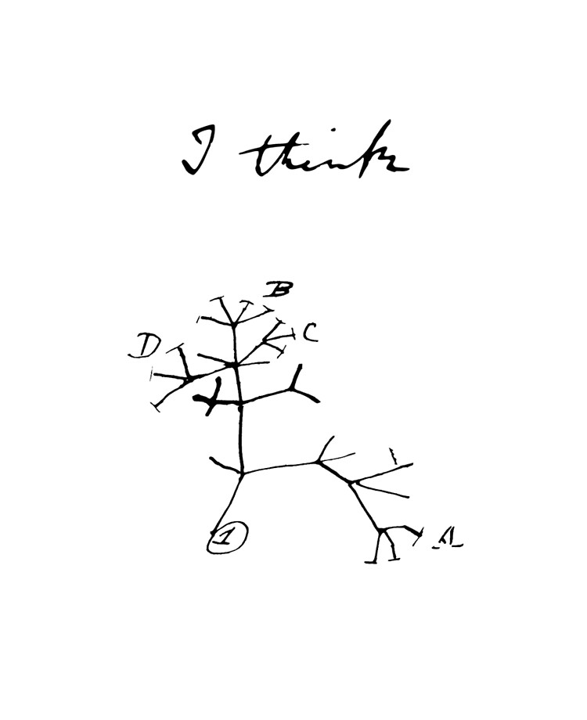
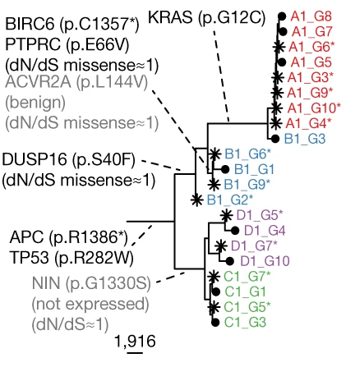
What is a model?
A model is a conceptual or mathematical abstraction of a system that serves to understand it
Our understanding of the natural world is couched in models
Conceptual models:
Qualitative description of a system
Identifies relevant properties of a system
Integrate disperse information obtained from different sources
Can be imprecise
Mathematical models:
Quantitative description of a system
Allows for non-intuitive predictions
Dynamic or static
Deterministic or stochastic
Phylogenetic tree of clonal relationships within a cancer
Househam et al., 2022
Darwin, 1837

Slide 5
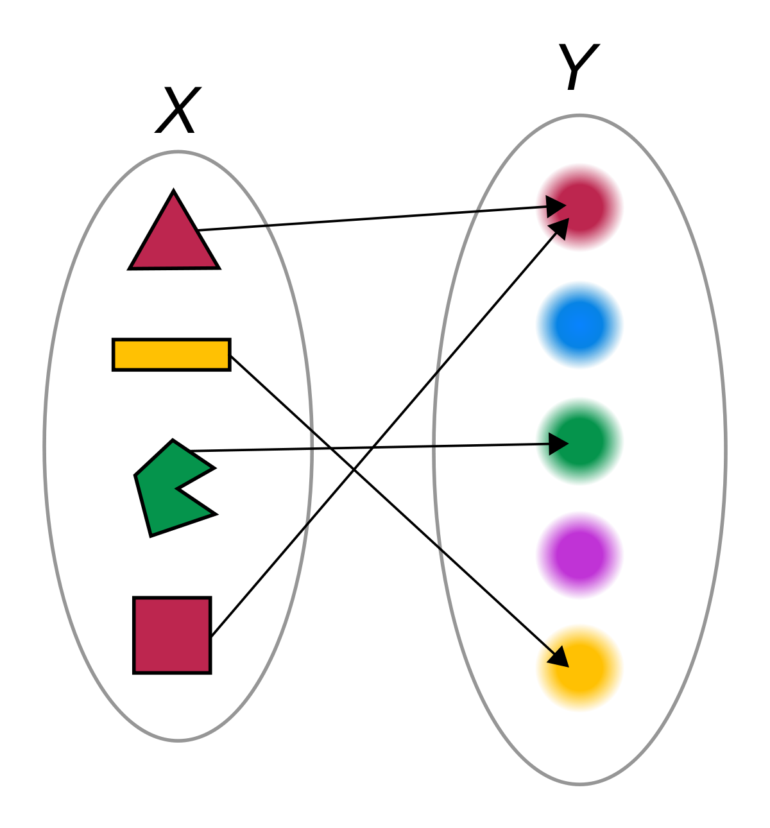
Mathematical models as a mapping
Generative mathematical models map biological properties (i.e. parameters) to the data we measure by representing the (complex) underlying process
Fitting those models solves the inverse problem, inferring the values of model parameters consistent with the data

Slide 6
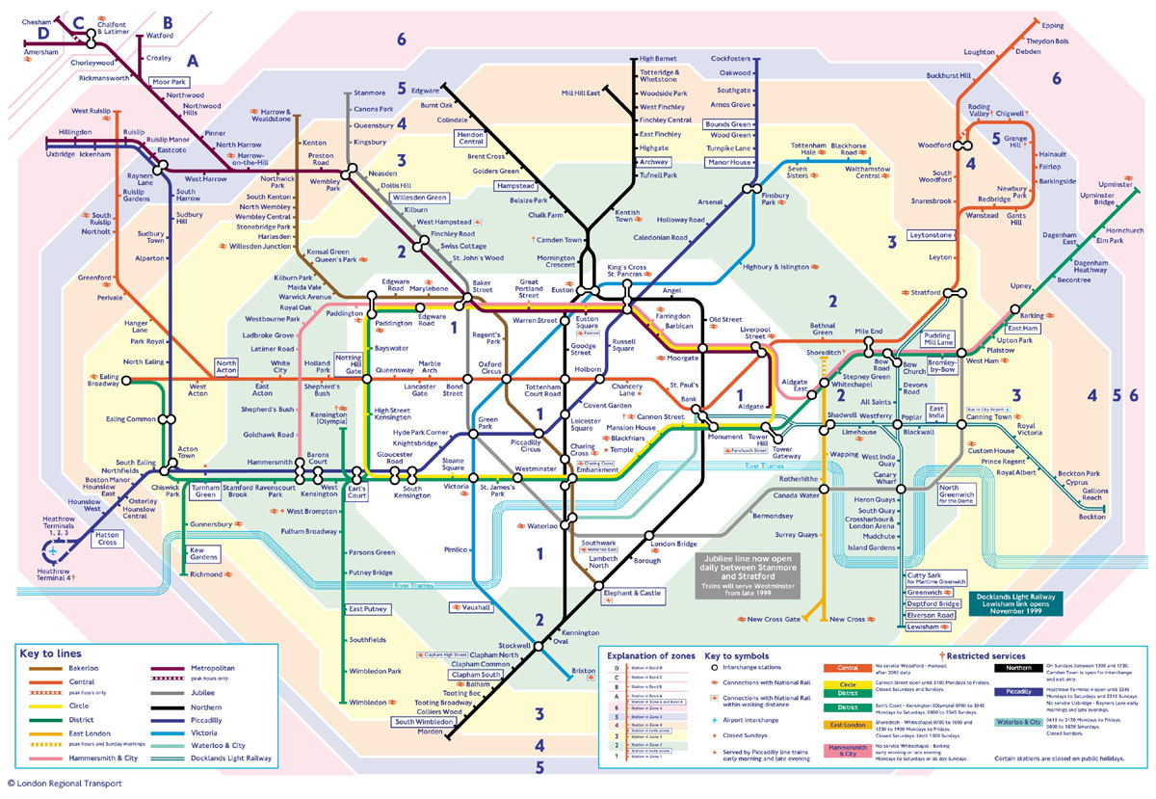
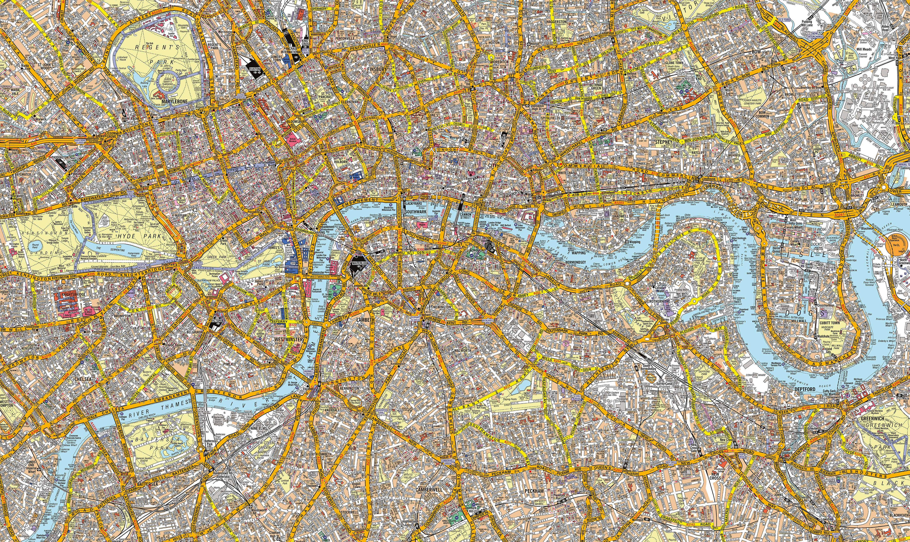
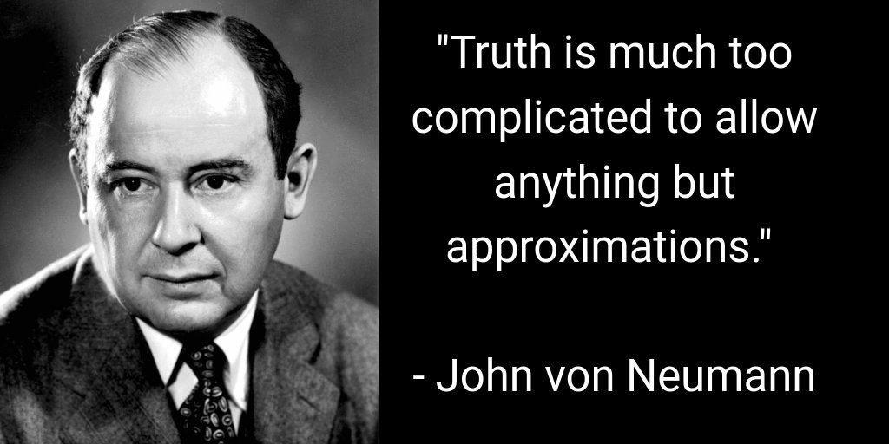
How simple is too simple?
All models (whether quantitative or qualitative) rely on approximations and simplifications
Overly complex models are prone to overfitting
The goal of the modeller is to make your model as simple as possible, but no simpler
The degree of accuracy required of a model is determined by its purpose
You can use Newtonian dynamics to put a satellite in orbit, but you need General Relativity for GPS
Which of these is a ”better” model of London?

Slide 7
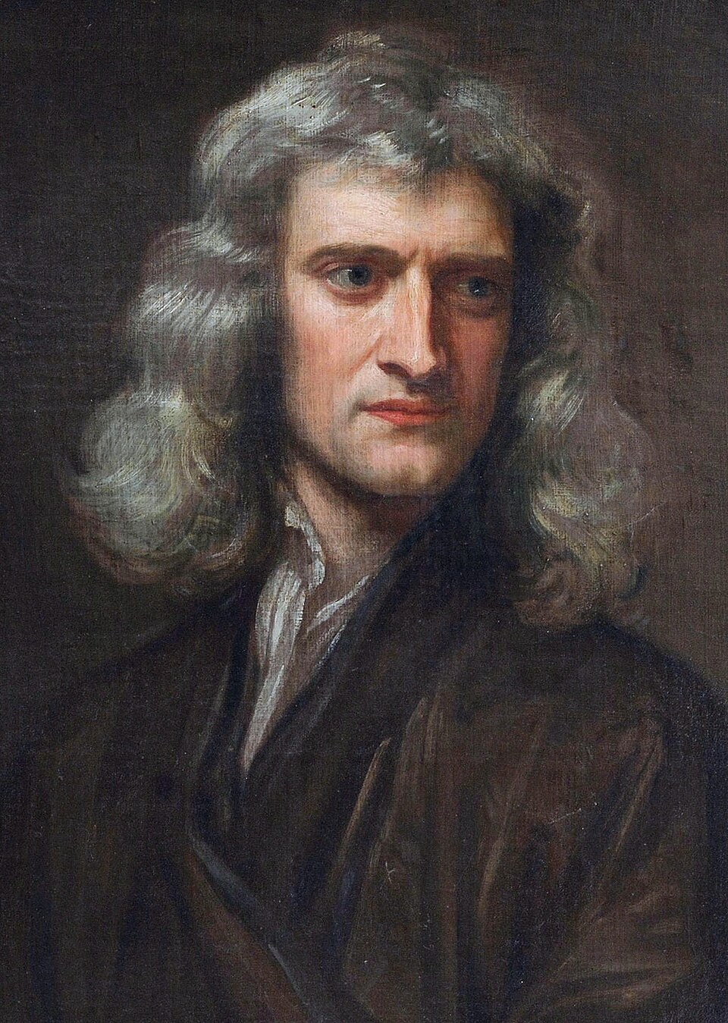
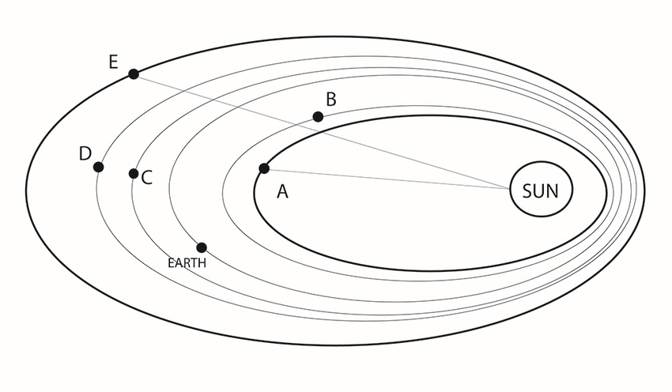
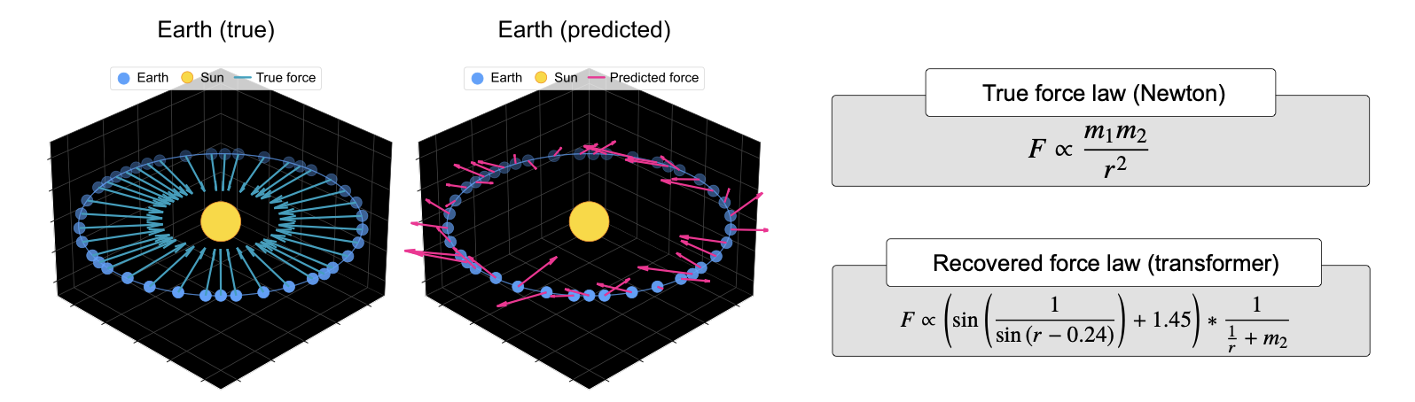
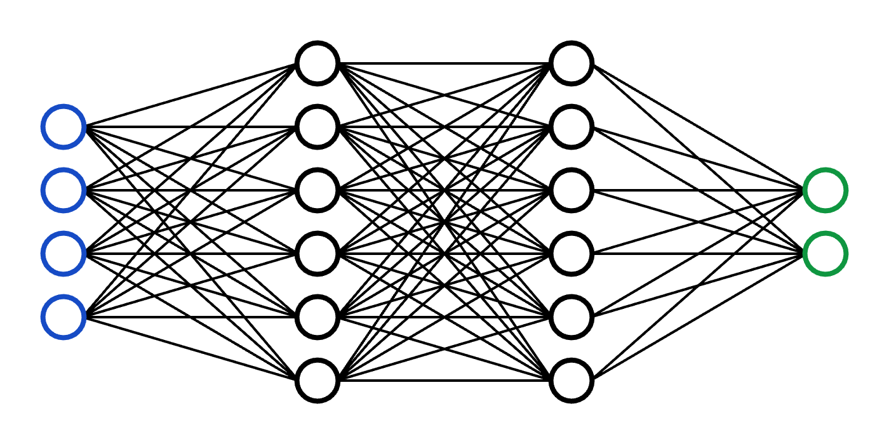

Training a transformer network to predict planetary positions does not recover Newtonian mechanics
Vs
Vafa et al 2025

Slide 8
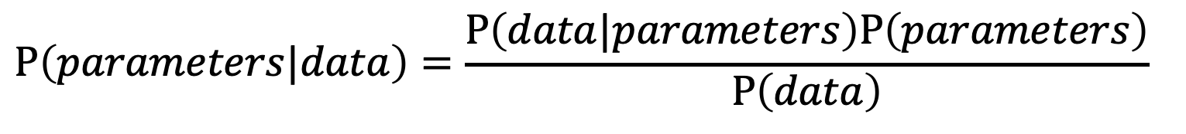
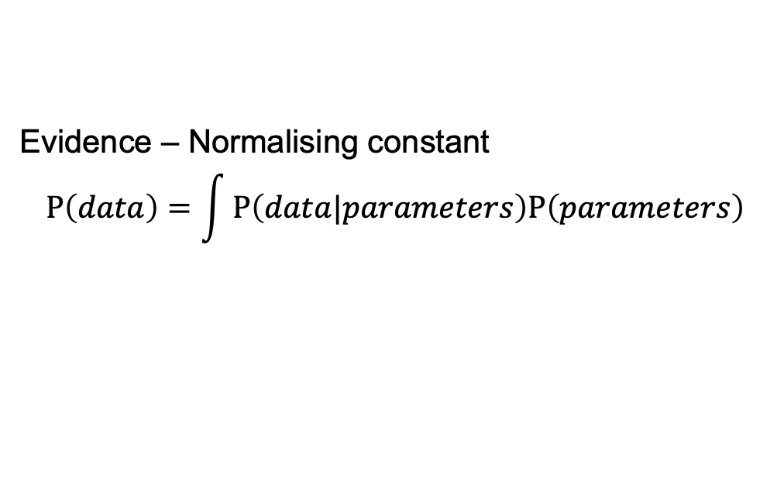
Bayes rule for fitting models to data
Prior – Encodes the investigator’s subjective beliefs about the reasonable range of the parameters
Likelihood – Encodes what we would expect the data to look like, given a certain set of parameters
$$P\left(parameters|data\right)=\frac{P\left(data|parameters\right)P\left(parameters\right)}{P\left(data\right)}$$
Posterior – Updated belief in the parameters after the model fit
Evidence – Normalising constant
$$P\left(data\right)=\int{P\left(data|parameters\right)P\left(parameters\right)}$$
Notes:
Difference compared to MLE - There may be many parameter combinations with very similar likelihoods and the likelihood surface may be multi-modal, making global optimisation difficult
Priors regularise problem (ruling out implausible regions of the parameter space)
Rather than simple point estimates for parameter values, can get plausible ranges of values, together with information on parameter identifiability and confounding

Slide 9
The importance of priors – Was Sally Clark guilty?
In 1999, Sally Clark was sent to prison for double homicide of her two children
Her defence argued both children died of sudden infant death syndrome (SIDS), but the prosecution’s expert witness stated “one sudden infant death in a family is a tragedy, two is suspicious and three is murder unless proven otherwise”
Between 1993 and 1996, the SIDS rate was 1 in 1300 births, so the prosecution argued that the probability of this occurring twice was <1 in 1 million, hence Clark was guilty – is their logic solid?
No!
The two events are not necessarily independent (genetic predisposition or environmental factors)
SIDS is rare, but homicide is even rarer (1 in 21,000) - what matters is the relative probability of double SIDS vs double homicide
Sally Clark was exonerated on appeal – her case has been labelled “one of the great miscarriages of justice in modern British legal history"

Slide 10
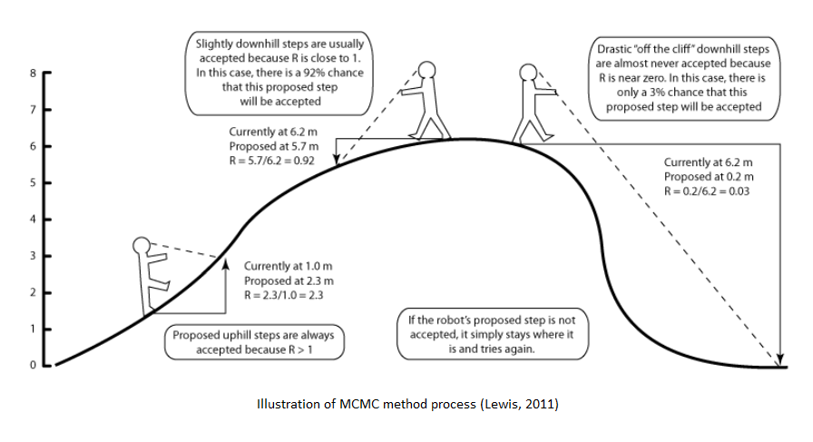
MCMC techniques allow one to sample from the posterior without integrating
Difficulty in calculating posterior comes in integrating the normalising constant
Lots of Bayesian inference tools to sample from the posterior when likelihood is well defined, for example:
Markov Chain Monte Carlo techniques
Metropolis-Hasting
Gibbs sampling
Hamiltonian Monte Carlo (HMC)
Nested sampling

Slide 11
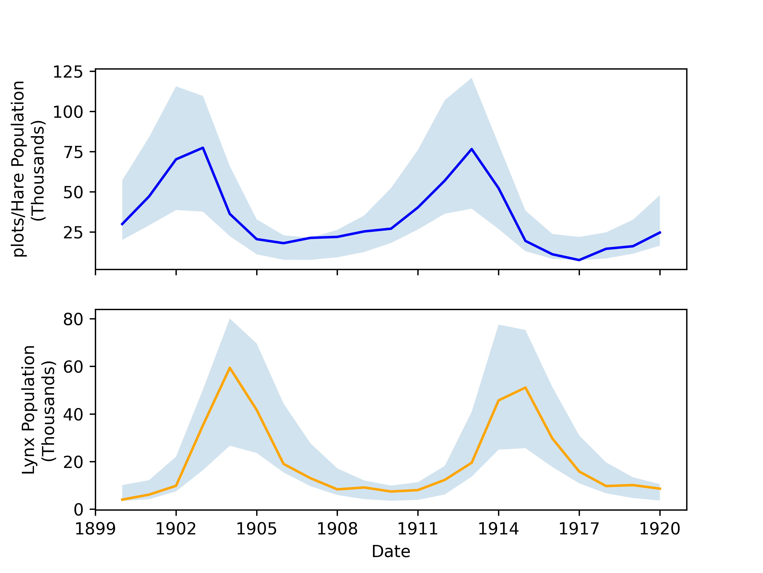
Diagnostics are important to check that you’ve sampled from the correct posterior
Run multiple chains in parallel with different starting conditions
If the chains display high autocorrelation, chains aren’t efficiently exploring the space
Simulate data for every point in your posterior and check that the simulated data distribution contains the real data
See Laura’s talk tomorrow!

Slide 12
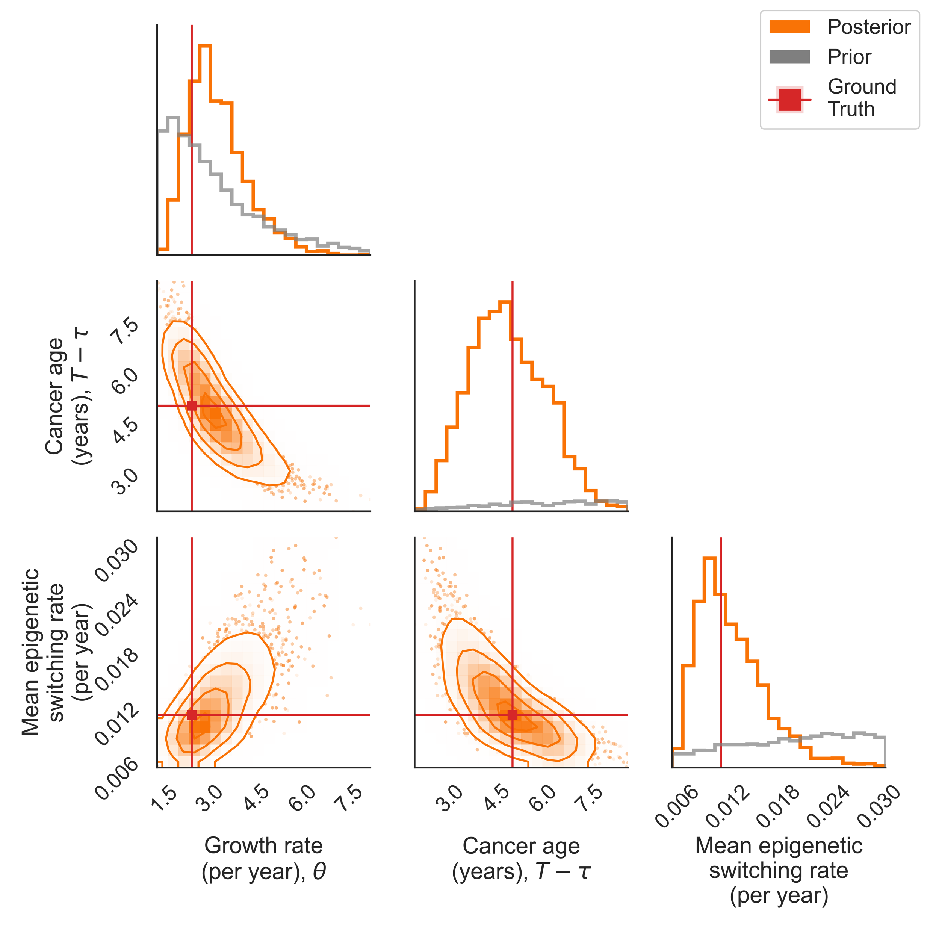
Use simulated data where you know the ground truth to check your inference’s robustness
Pairs plots show the marginal posterior distribution
Can be used to check for correlations in your posterior
Comparison with the prior is important to check your parameters are informed by data

Slide 13

How to decide which model best fits the data?
A complex model with lots of free parameters will typically do a better job of fitting data, at the risk of overfitting
How can we balance complexity vs model fit?
Jon and Lloyd will tackle this problem in detail

Slide 14
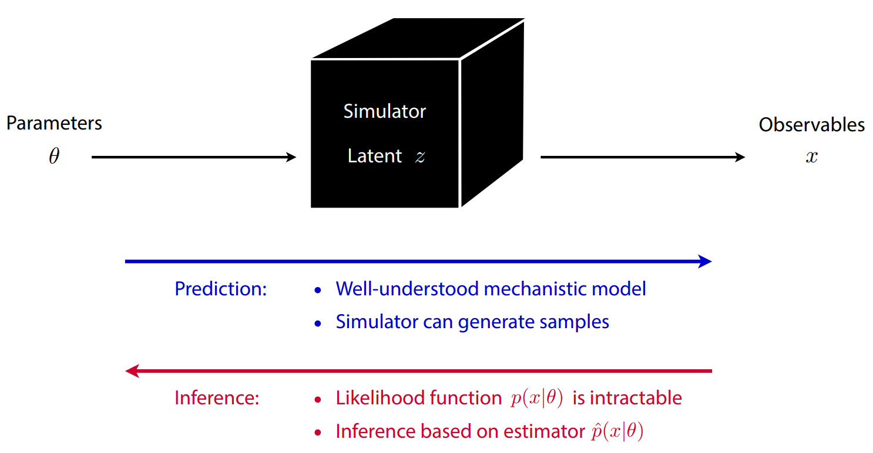
What if we don’t have a likelihood?
It is often easier to simulate a complex system than it is to write down the corresponding likelihood function

Slide 15
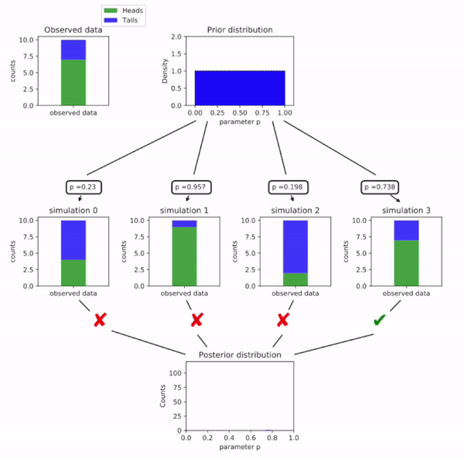
Simulations can be used to model complex systems
Approximate Bayesian Computation (ABC)
Use your model to simulate some data for a given set of parameters
Compare the simulated data to real data and keep parameters that give similar simulations
Repeat
The set of parameters that have been accepted constitute your “fit”

Slide 16
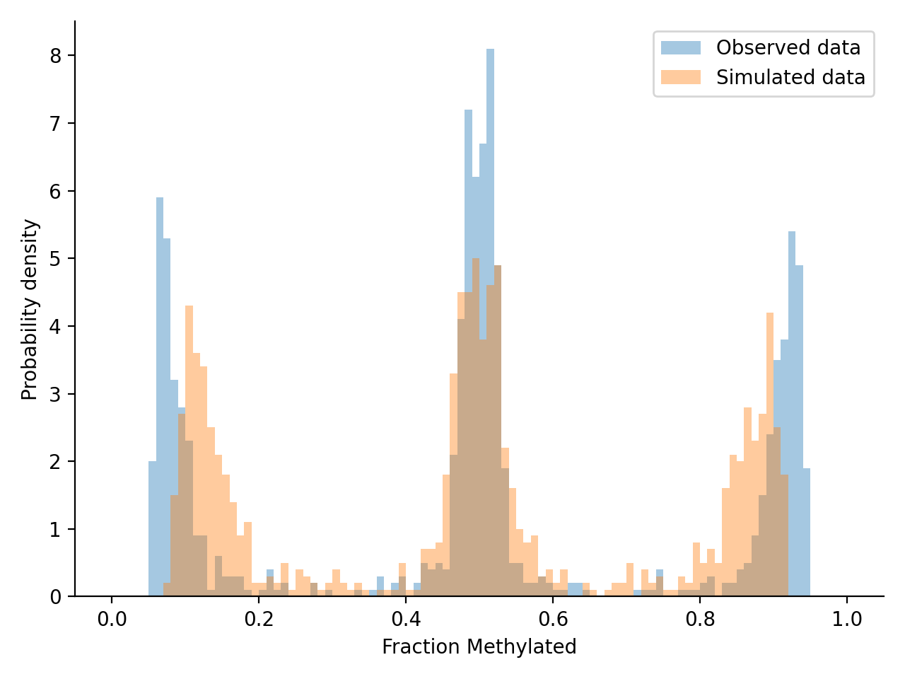
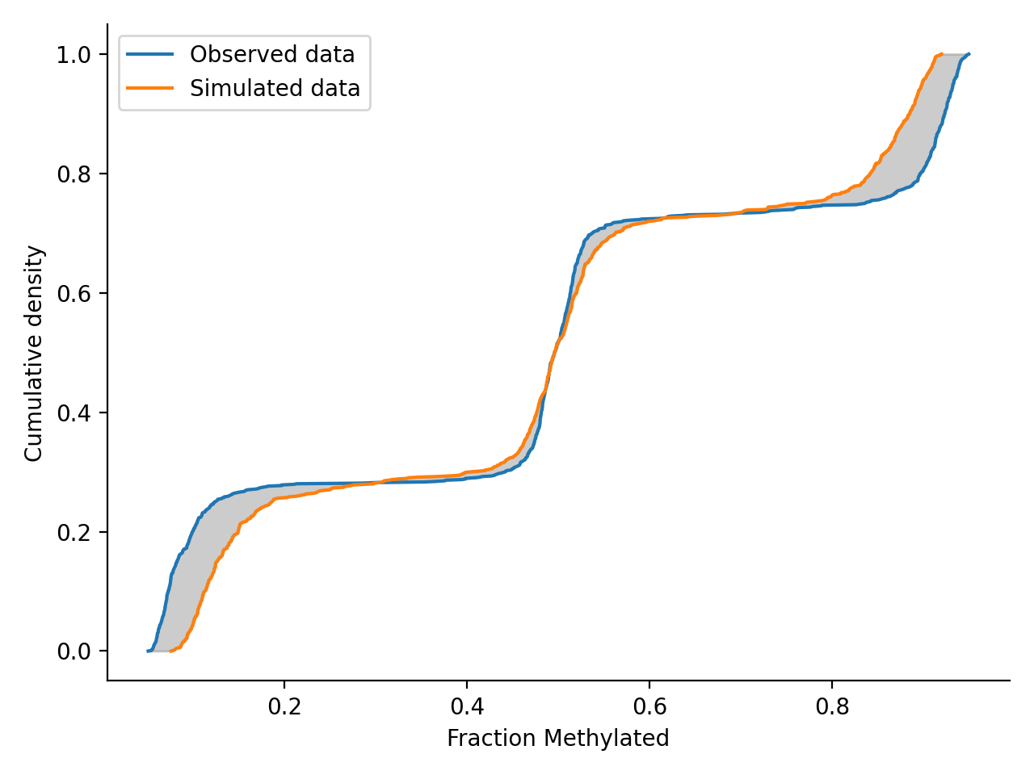
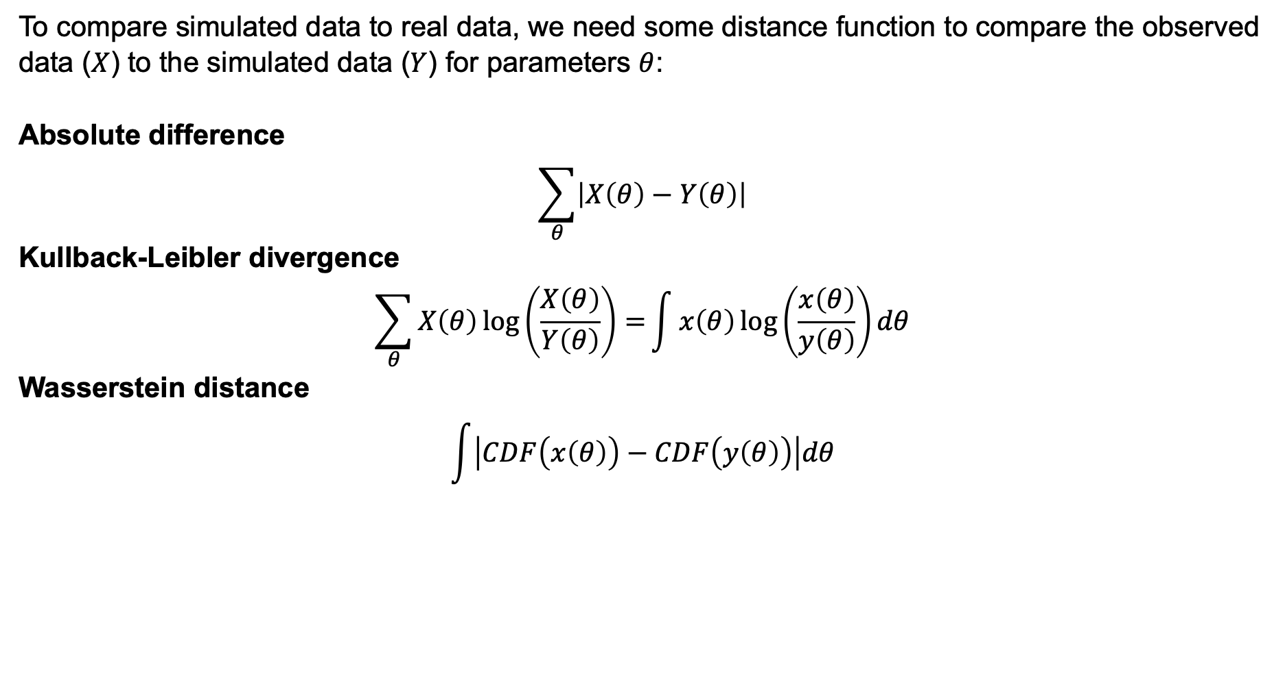
Distance metrics quantify how similar simulated data is to real data
To compare simulated data to real data, we need some distance function to compare the observed data ($X$) to the simulated data ($Y$) for parameters $θ$:
Absolute difference
$$\sum_{θ}{\left|X\left(θ\right)−Y\left(θ\right)\right|}$$
Kullback-Leibler divergence
$$\sum_{θ}{X\left(θ\right)\log\left(\frac{X\left(θ\right)}{Y\left(θ\right)}\right)=}\int{x\left(θ\right)\log\left(\frac{x\left(θ\right)}{y\left(θ\right)}\right)dθ}$$
Wasserstein distance
$$\int{\left|CDF\left(x\left(θ\right)\right)−CDF\left(y\left(θ\right)\right)\right|dθ}$$
Wasserstein
distance
Notes:
Kullback-Leibler divergence is relative entropy: ”A simple interpretation of the divergence of X from Y is the expected excess surprise from using Y as a model when the actual distribution is X.”
Wasserstein distance is also called the “earth mover distance” and for univariate data can be considered as the difference in area between the two CDFs

Slide 17
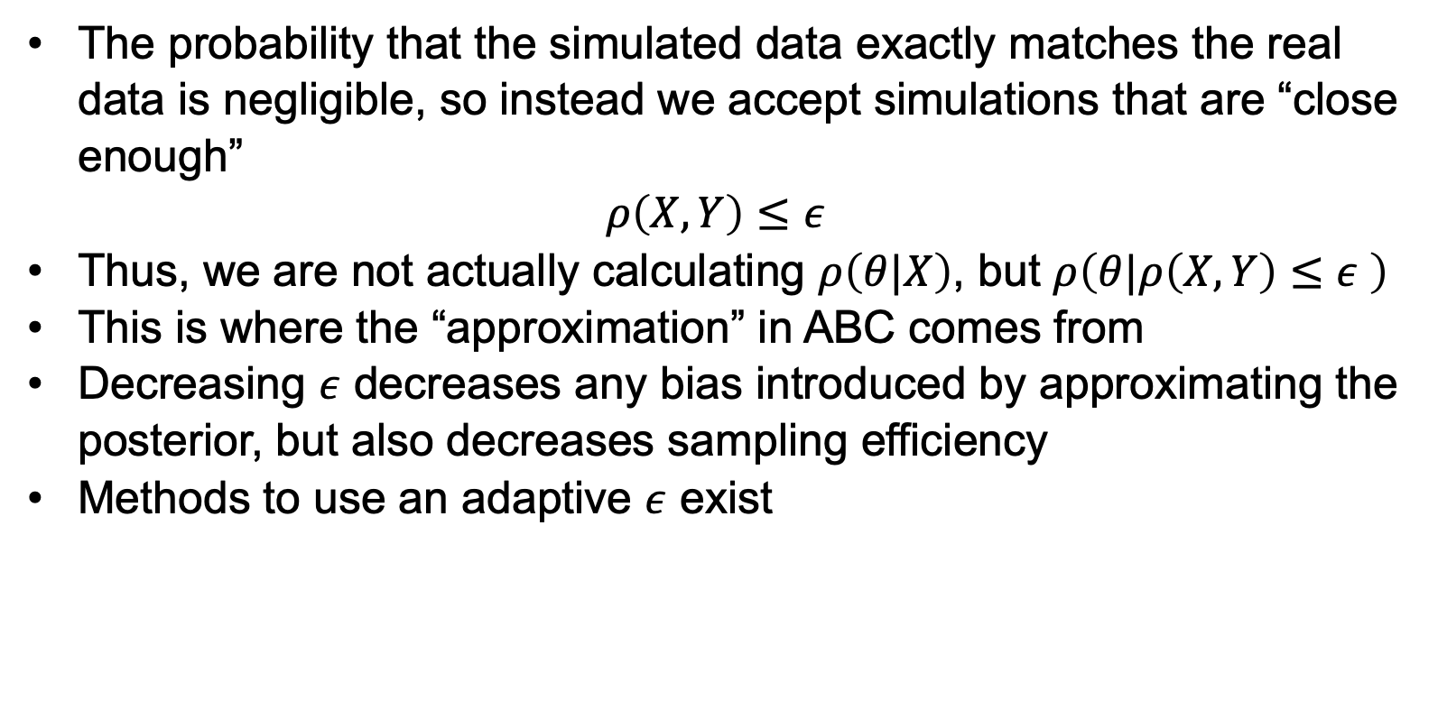
Tolerance cut-off inevitably introduce bias into our posterior estimation
The probability that the simulated data exactly matches the real data is negligible, so instead we accept simulations that are “close enough”
$$ρ\left(X,Y\right)≤ε$$
Thus, we are not actually calculating $ρ\left(θ|X\right)$, but $ρ\left(θ|ρ\left(X,Y\right)≤ε \right)$
This is where the “approximation” in ABC comes from
Decreasing $ε$ decreases any bias introduced by approximating the posterior, but also decreases sampling efficiency
Methods to use an adaptive $ε$ exist

Slide 18
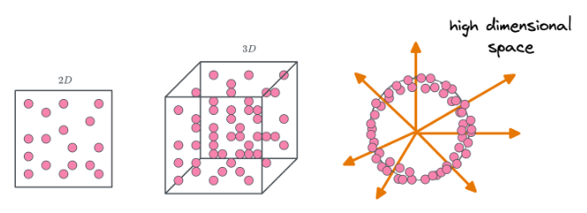
The curse of dimensionality makes parameter inference in high dimensions difficult

Slide 19
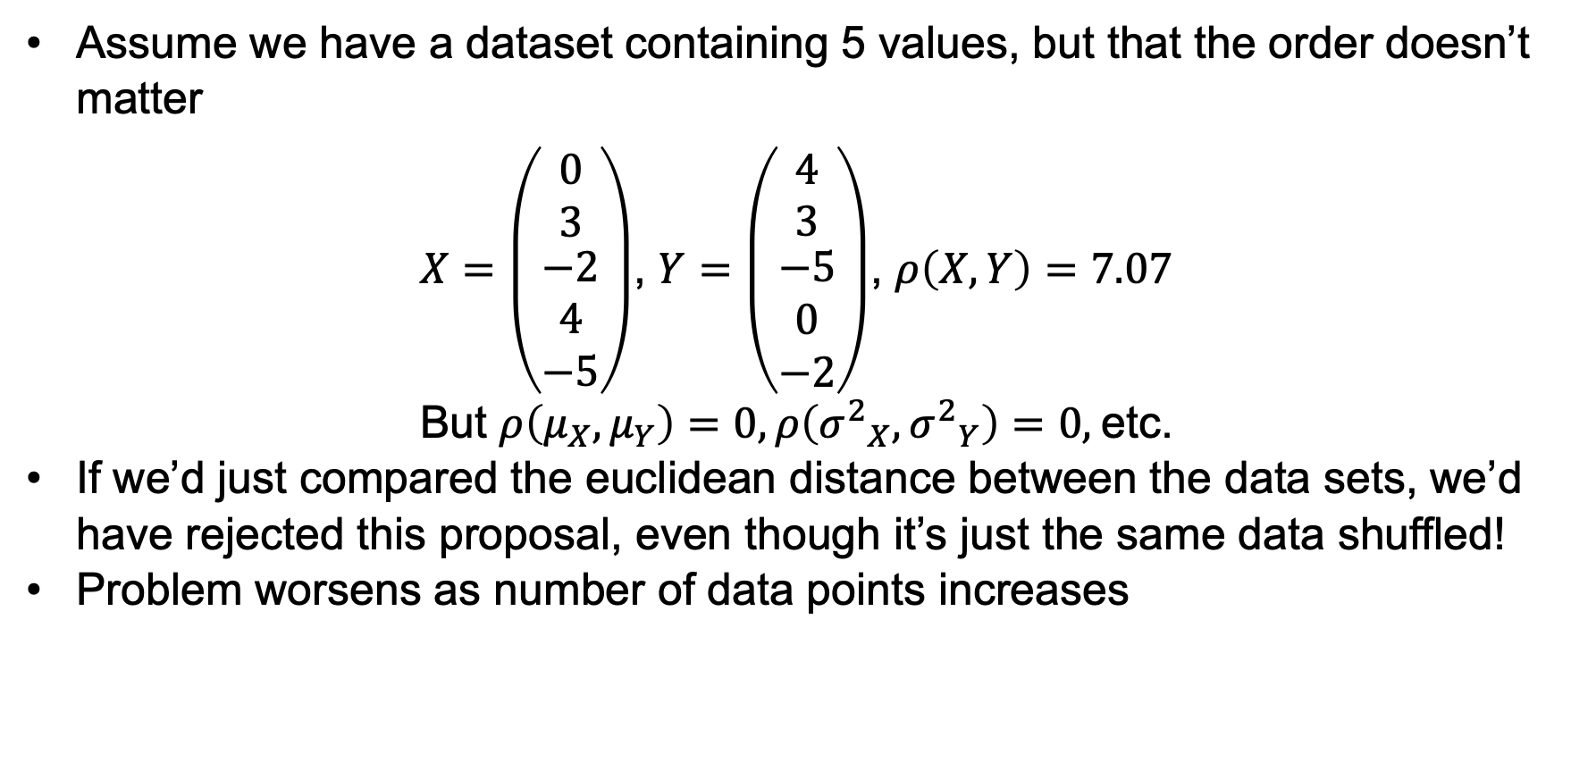
Summary statistics can help reduce data dimensionality and massively improve inference
Assume we have a dataset containing 5 values, but that the order doesn’t matter
$X=\left(\begin{matrix}0 \\ 3 \\ \begin{matrix}−2 \\ 4 \\ −5\end{matrix}\end{matrix}\right)$, $Y=\left(\begin{matrix}4 \\ 3 \\ \begin{matrix}−5 \\ 0 \\ −2\end{matrix}\end{matrix}\right)$, $ρ\left(X,Y\right)=7.07$
But $ρ\left(μ_{X},μ_{Y}\right)=0, ρ\left({σ^{2}}_{X},{σ^{2}}_{Y}\right)=0,$etc.
If we’d just compared the euclidean distance between the data sets, we’d have rejected this proposal, even though it’s just the same data shuffled!
Problem worsens as number of data points increases
Notes:
Often, rather than compare the synthetic data to the observed data directly, we want to use summary statistics to reduce the dimensionality of the output space, improving efficiency.

Slide 20
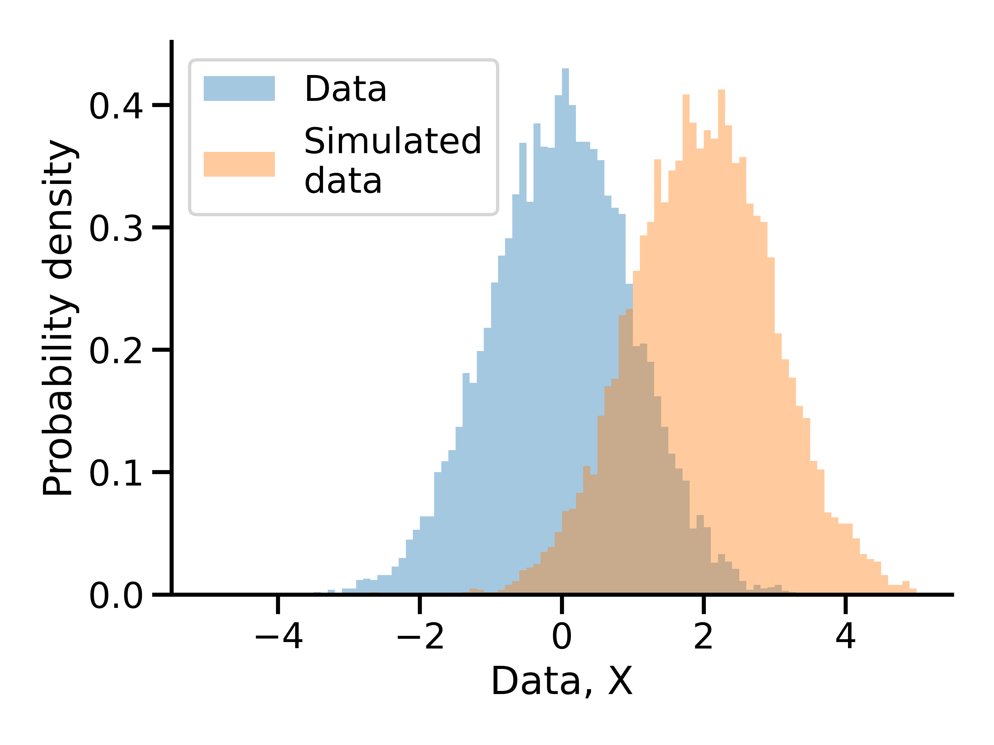
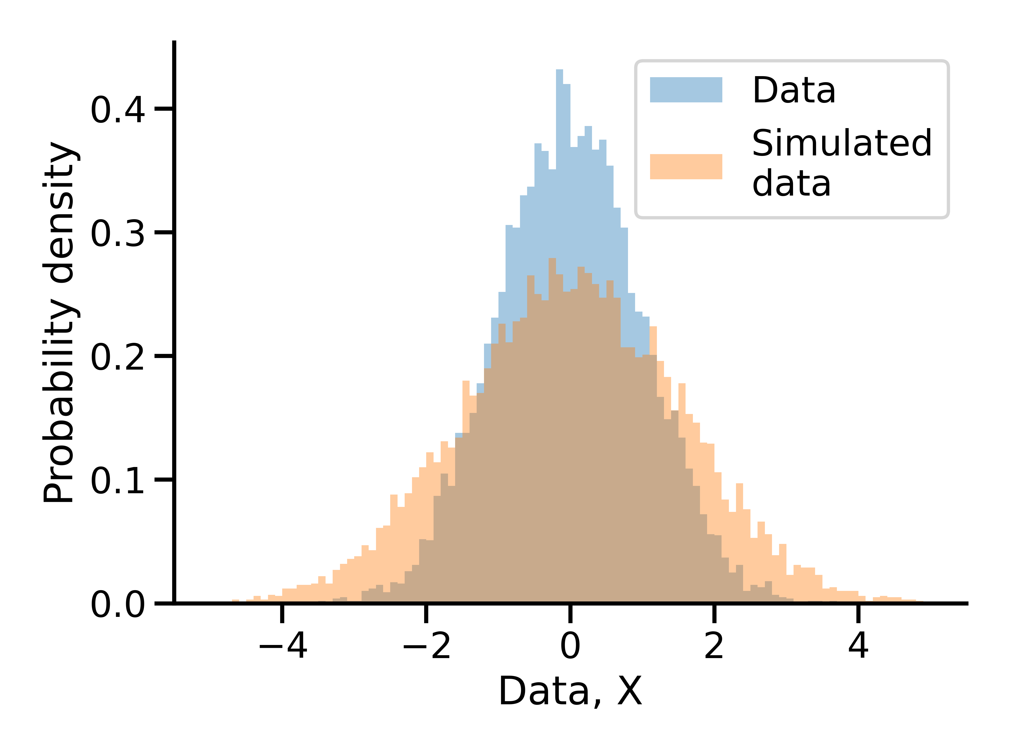
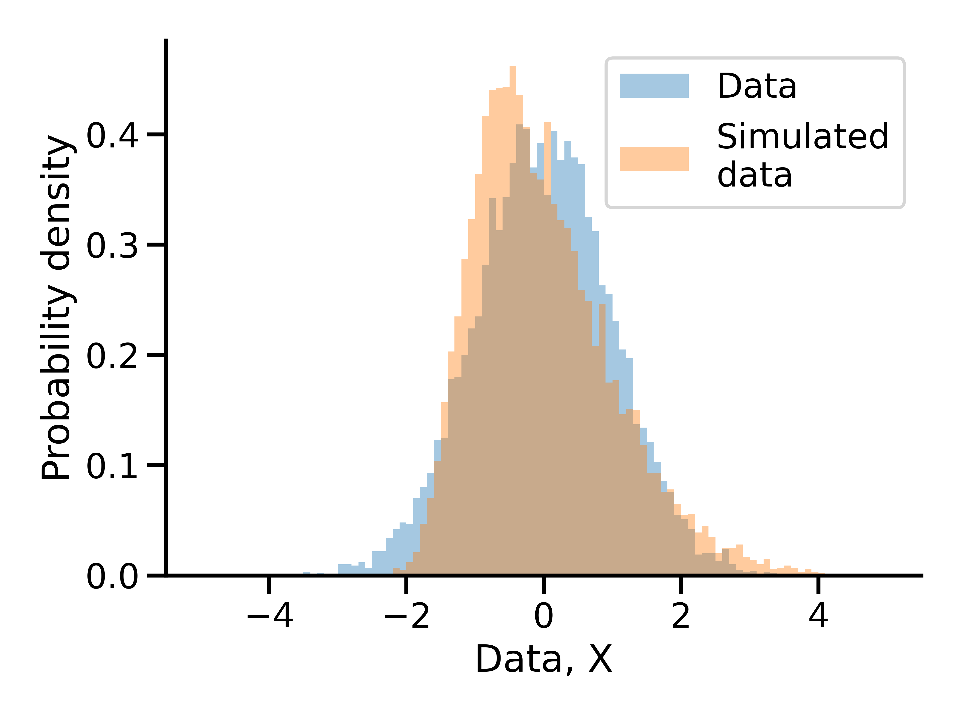
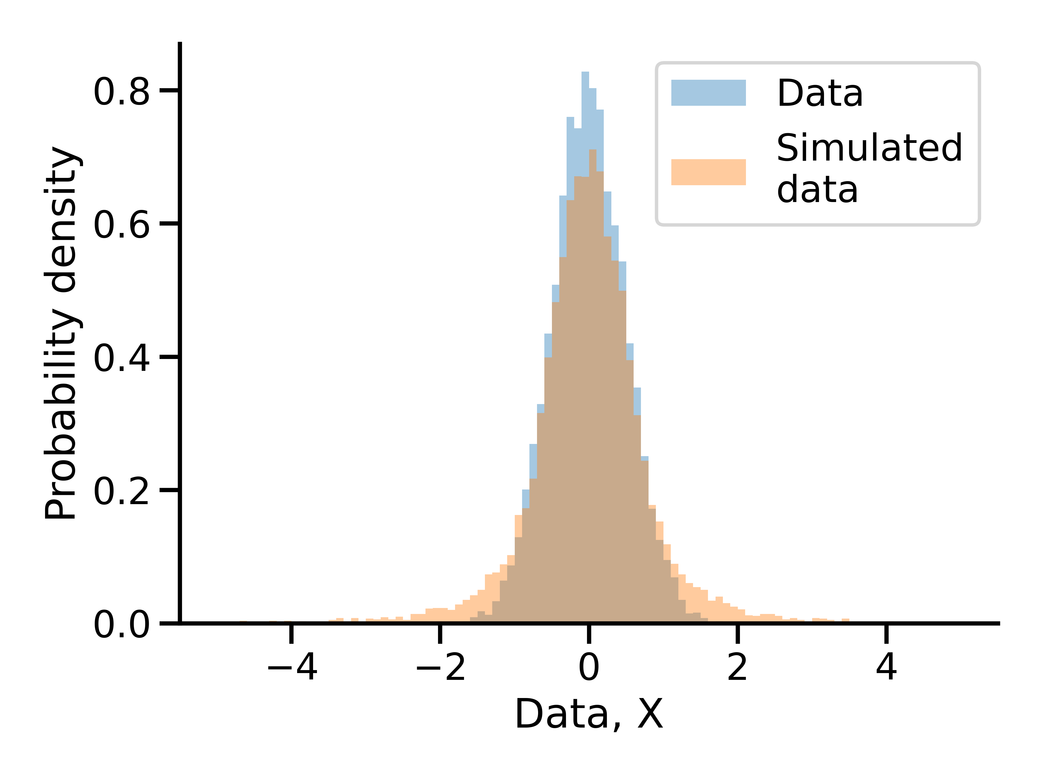
Summary statistics should be “sufficient”
Need enough summary statistics to wholly represent the observed datasets, but too many summary statistics also decreases sampling efficiency
Means
Variance
Kurtosis
Skew

Slide 21
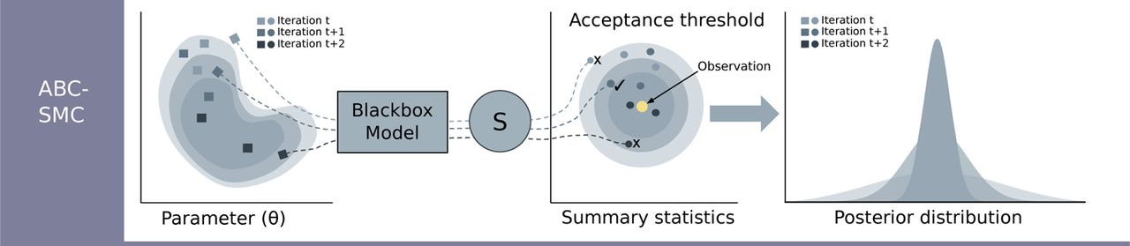

ABC algorithms can improve inference efficiency
So far, we’ve focused on rejection ABC, but more complicated ABC algorithms exist
Mainly focused on using existing existing points in the posterior to suggest new points, increasing sampling efficiency
Examples
MCMC ABC
Sequential Monte Carlo ABC
Population Monte Carlo ABC
Simulated annealing ABC
Generally, much more efficient than rejection-based methods, but samples are not necessarily independently drawn from posterior
Adaptive $ε$
Alamoudi et al., 2023
Notes:
MCMC ABC – random walk using position of current proposal to generate next proposal using a Metropolis-Hastings rejection step
Sequential Monte Carlo ABC – sequence of (decreasing) tolerances. Construct intermediate posterior for $ε_{1}$ + calculate a weight for each accepted particle. Sample the intermediate posterior according to weights + generate a new proposal according to a perturbation kernel and accept with tolerance $ε_{2}$. Repeat until final tolerance $ε_{T}$.
Population Monte Carlo ABC – Similar to SMC, but PMC uses importance sampling weights for pruning the sample instead of accepting or rejecting a given particle, so every step of the process yields samples from the posterior. E.g. Sample from proposal distribution on parameter space. Accept only "close" parameters. Reduce tolerance. New proposal distribution. Adjust the sampled proportions by multiplying by weight = π/g to account for the fact we’re sampling from the proposal distribution rather than the prior. Samples more from high density regions of the posterior.
SMC and PMC are iterated importance samplers.

Slide 22
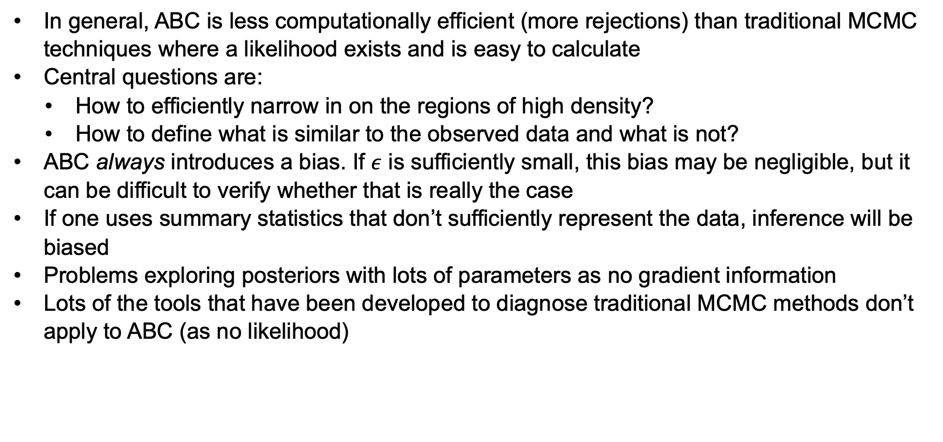
Drawbacks of ABC
In general, ABC is less computationally efficient (more rejections) than traditional MCMC techniques where a likelihood exists and is easy to calculate
Central questions are:
How to efficiently narrow in on the regions of high density?
How to define what is similar to the observed data and what is not?
ABC always introduces a bias. If $ε$ is sufficiently small, this bias may be negligible, but it can be difficult to verify whether that is really the case
If one uses summary statistics that don’t sufficiently represent the data, inference will be biased
Problems exploring posteriors with lots of parameters as no gradient information
Lots of the tools that have been developed to diagnose traditional MCMC methods don’t apply to ABC (as no likelihood)

Slide 23
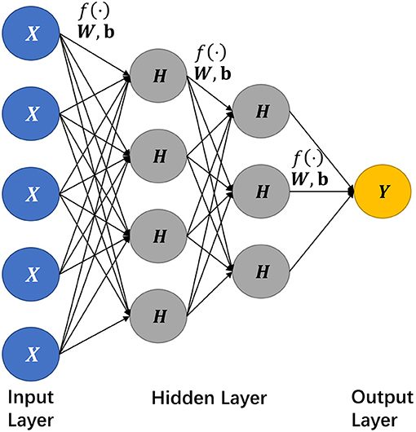
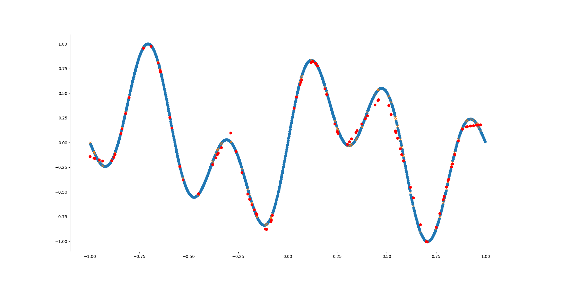
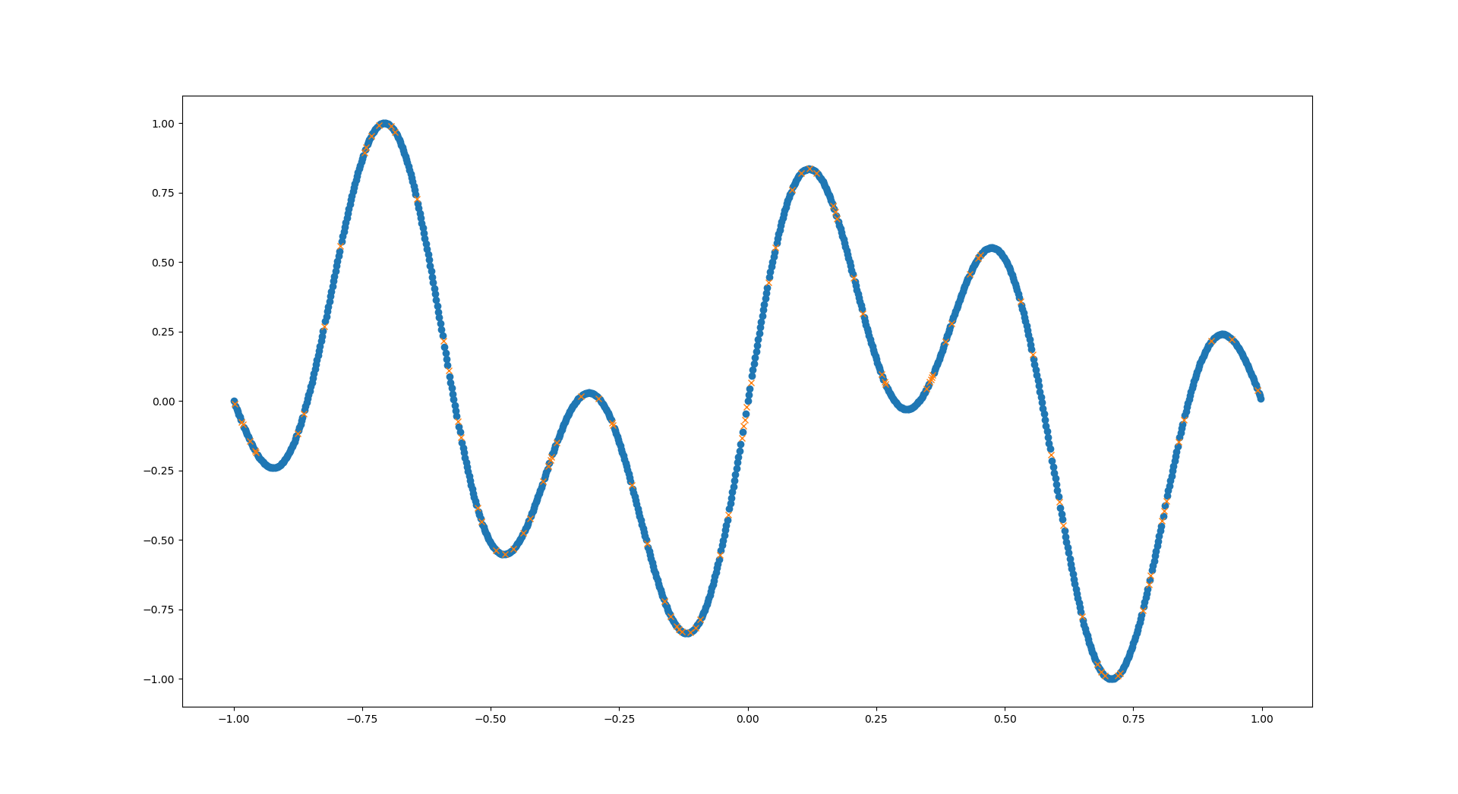
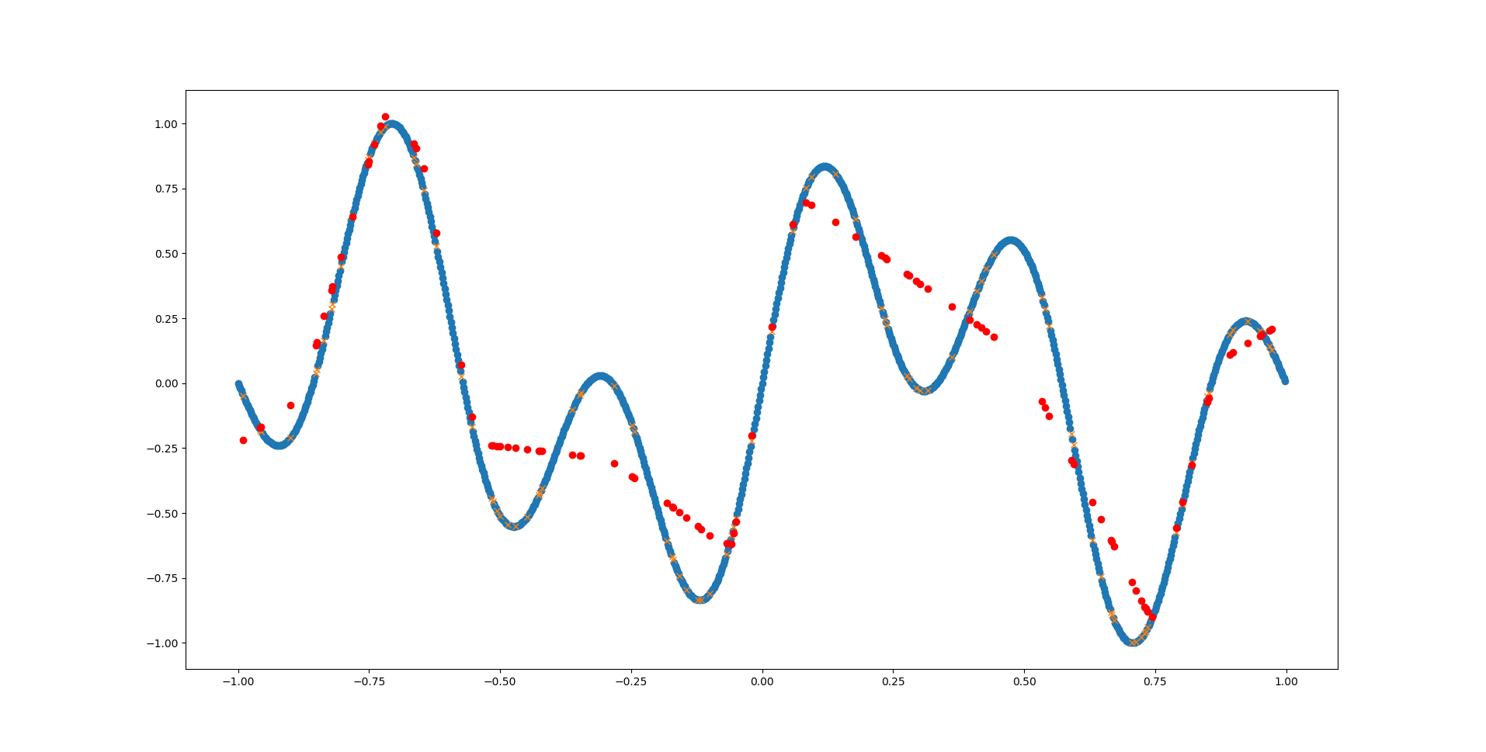
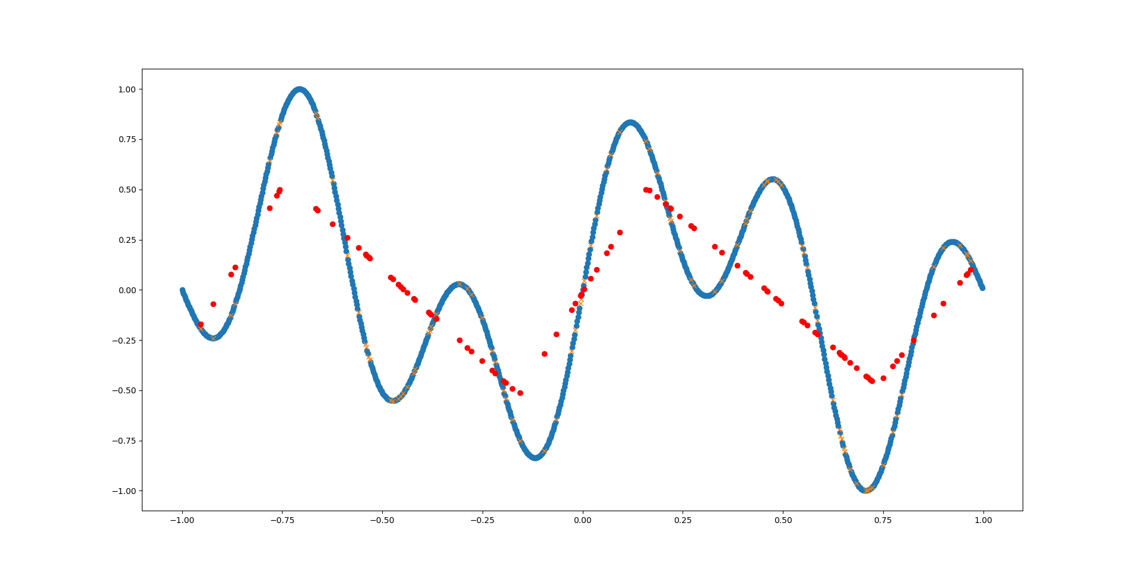
ABC seems inefficient, can’t we use neural networks instead?
Neural networks are fundamentally function approximation algorithms
Adding more hidden layers with more nodes allows the network to model functions with increasing complexity
Tang et al, 2019

Slide 24
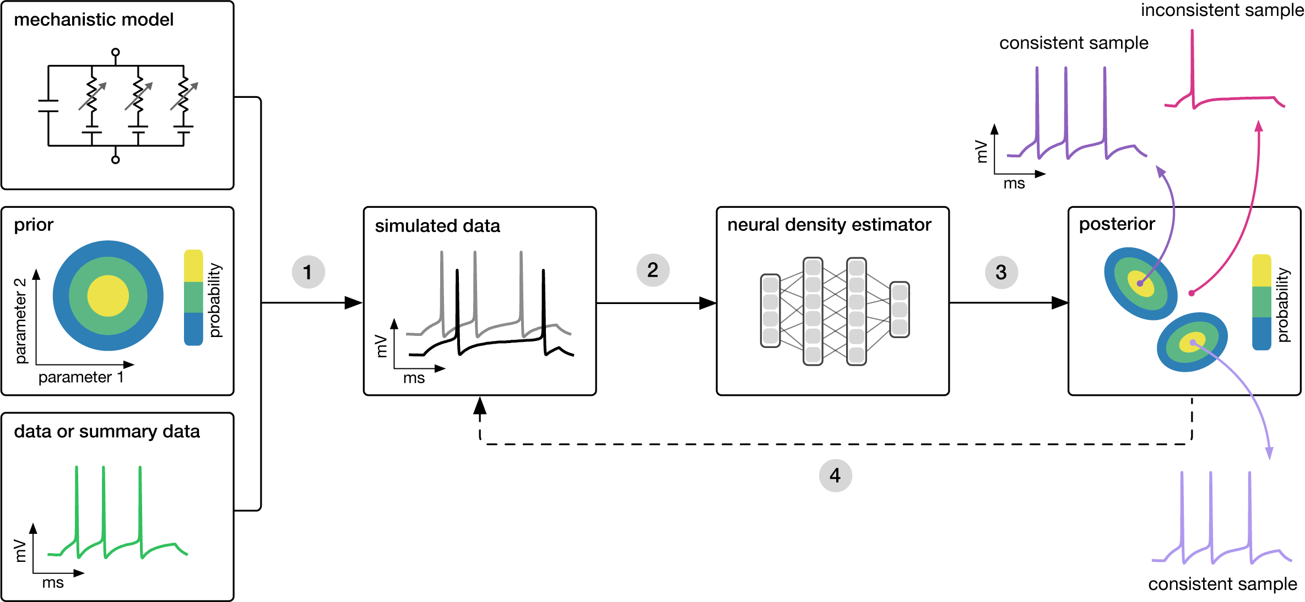
Neural networks can accelerate simulation-based inference
Amortised!
Tejero-Cantero et al., 2022

Slide 25
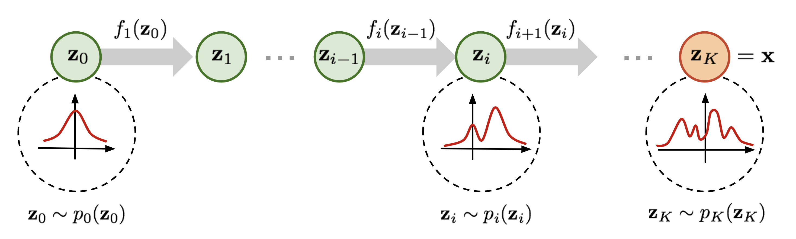
Normalising flows allow neural networks to model distributions, rather than just point values
Simple distribution
Arbitrarily complex distribution
NF properties
Sample easily
Compute exact log probabilities
Train via maximum likelihood
K invertible
transformations

Slide 26
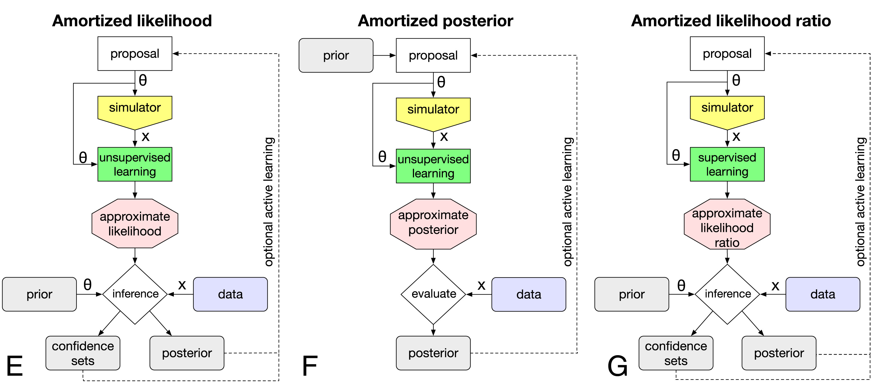
3 families of amortised inference
Directly learn the mapping between data and parameters
Cranmer et al., 2020

Slide 27
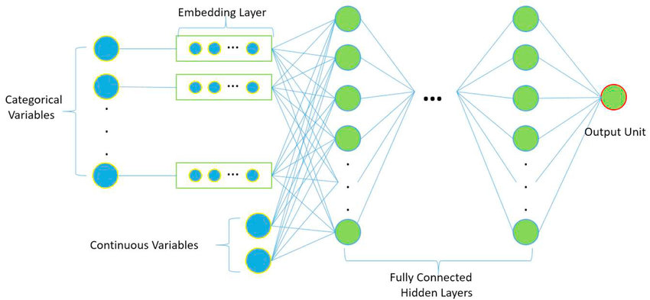
Embedding layers allow for automatic dimensionality reduction

Slide 28
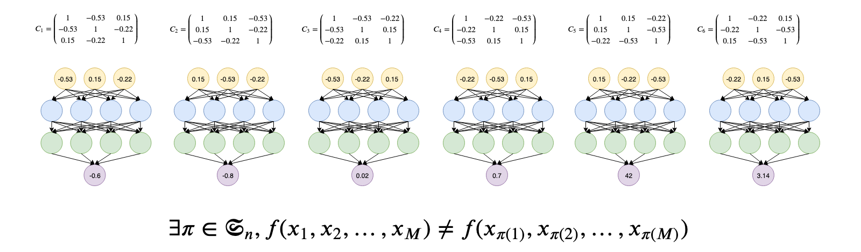
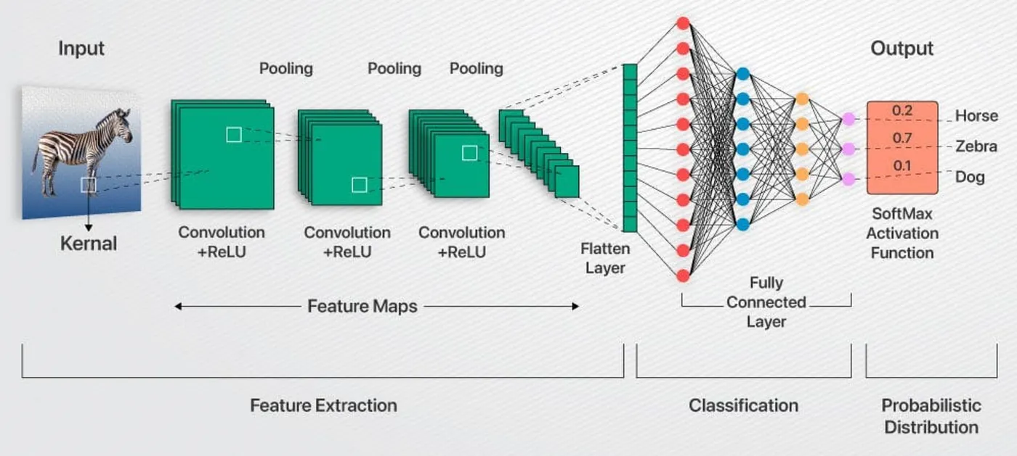
The structure of your embedding should be tailored to your data
i.i.d. data: NLE or permutation-invariant embedding
Spatial structure: CNN or ResNet

Slide 29
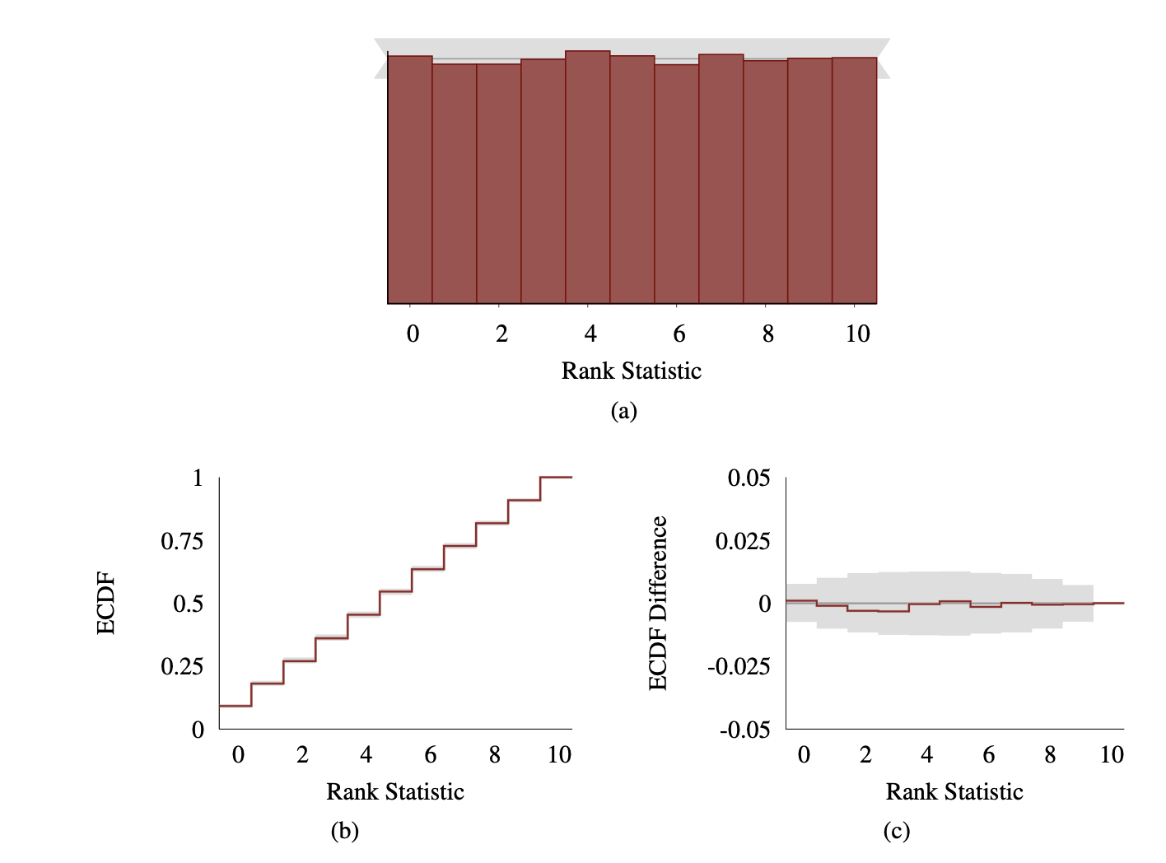
Simulation-based calibration (SBC) checks test whether your neural network generates valid posterior samples
Because NPE is amortised, we can efficiently resimulate data from our prior, fit our trained NN to each parameter set and test whether the learned posterior is miscalibrated
Relies on the fact that, for a well-calibrated posterior, the rank (i.e. how much posterior mass is below the ground truth) should follow a uniform distribution
Should be calculated alongside posterior predictive checks

Slide 30
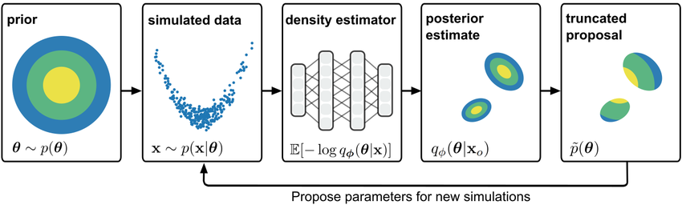
SBI can also be run in a sequential manner
The resulting neural network is no longer amortised

Slide 31

Summary
Models
It’s models all the way down…
Mathemaical models enable quantitative predictions and provide evidence for a hypothesis
Different problems necessitate different fitting algorithms:
Closed form likelihood exists – MCMC
Only simulations are available – ABC/SBI
Need an amortised solution – SBI
The appropriate summary statistic/network embedding can speed up inference massively
But it comes at the risk of information loss/biasing your inferred parameters
Models
Models
Models
Models

Slide 32
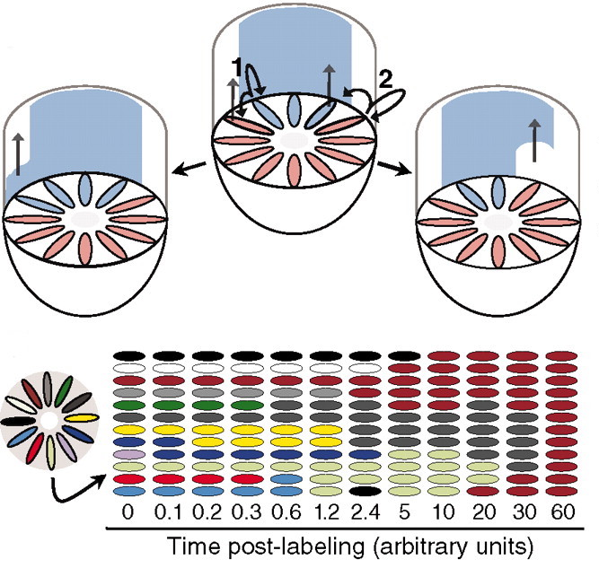
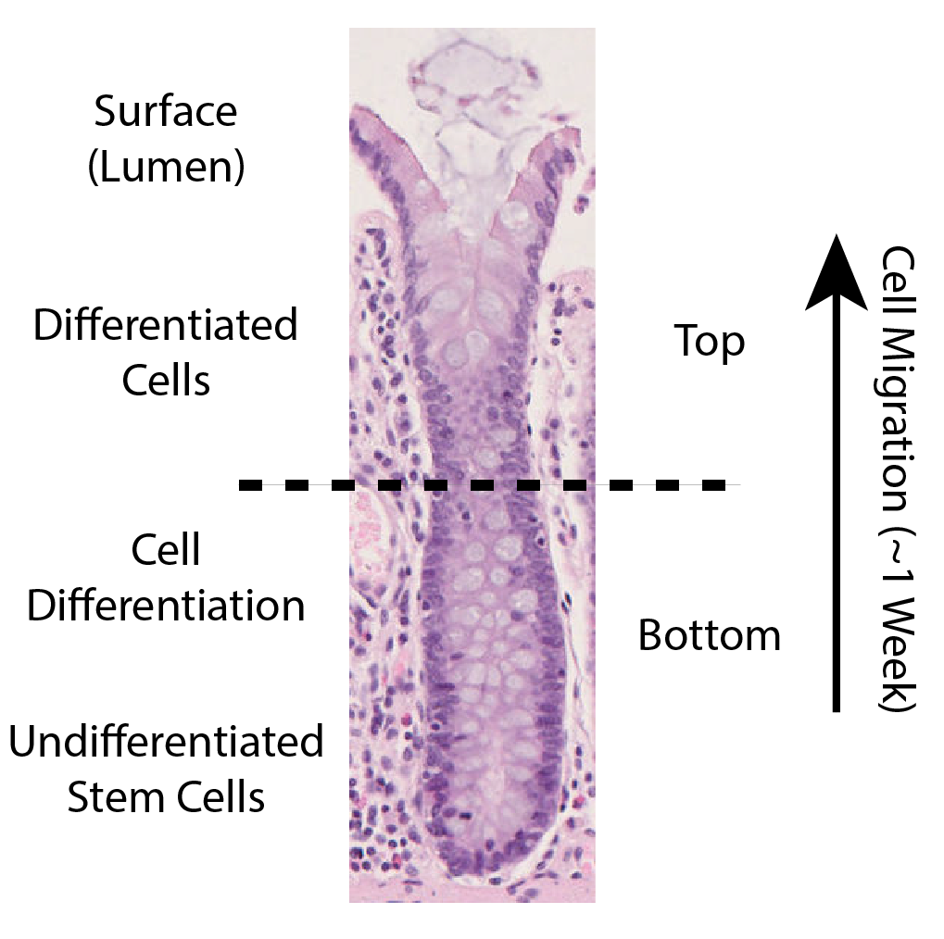
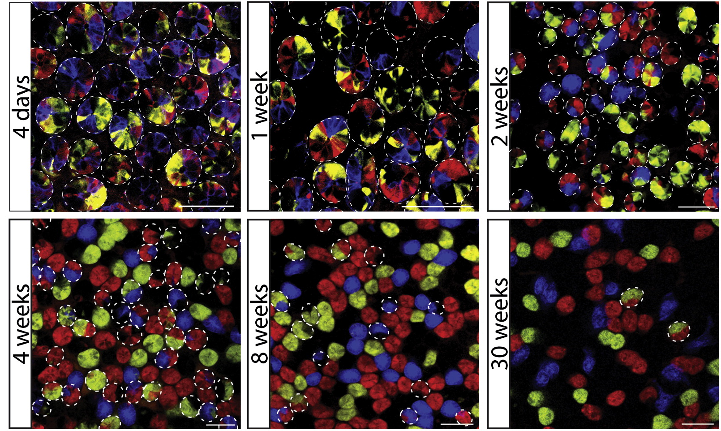
Example biological problem – Stem cell dynamics of colonic crypts
Lopez-Garcia, C. et al. (2010)
Snippert, H. J. et al. (2010)

Slide 33
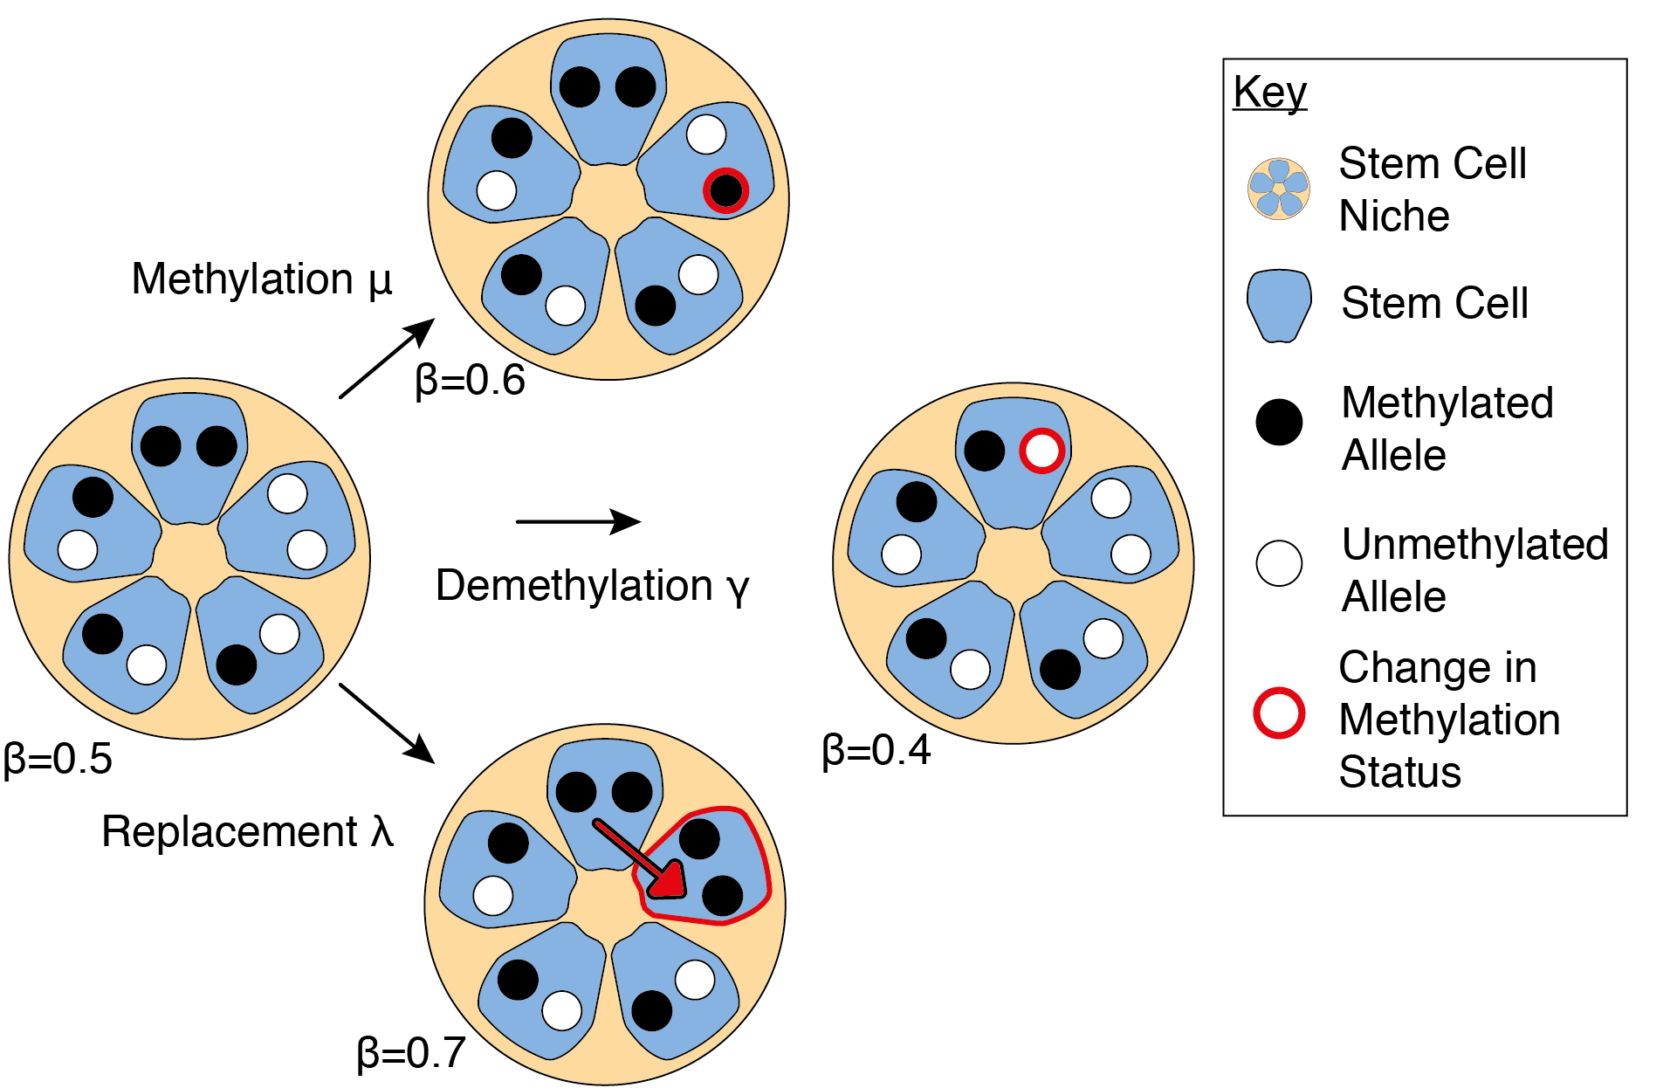
SBI Project - Explore how to use simulation-based inference to do rapid amortised inference of a real biological system
+
Gabbutt et al. (2022)
Tejero-Cantero et al. (2022)

